Slide 1
AUTOMATIC DIFFERNTIATION

Slide 2
Automatic Differentiation, also known as Algorithmic differentiation. It is used to find derivative of computer programs. Why go with automatic differentiation? Programs are the new way of writing mathematical formulas, and uses complex constructs like recursion, loops, switch statements and modular functions to define these mathematical functions. In most cases, as is the case with our MSERT model, even though it being a physics based model with ODEs (a white box model) we more or less treat it as a black box model*, since we have no way to tap into the structure of our mathematical formulas. AD helps us resolve this issue. Also as ML and AI will mature with time, a general purpose machine learning language will emerge, which will have Automatic differentiation at it’s core. These ANN, CNN and other deep learning networks we talk about wouldn’t have been possible without Algorithmic Differentiation. Another name for Reverse Mode Algorithmic Differentiation is Back-propagation. Uses of derivatives - 1. Optimization. 2. Sensitivity Analysis. 3. Parameter estimation of models, using methods like Gradient Descent. 4. Deep Learning and Neural ODEs. 5. Optimal Control. (using adjoint differentiation through direct method) 6. Bayesian Network & HMM 7. Computational Finance
KEY POINTS
* When I say black box here, I don’t mean actual black box, but since we are not able to access the structure of our model, it is as good as any black box model as far as any analysis is concerned.

Slide 3
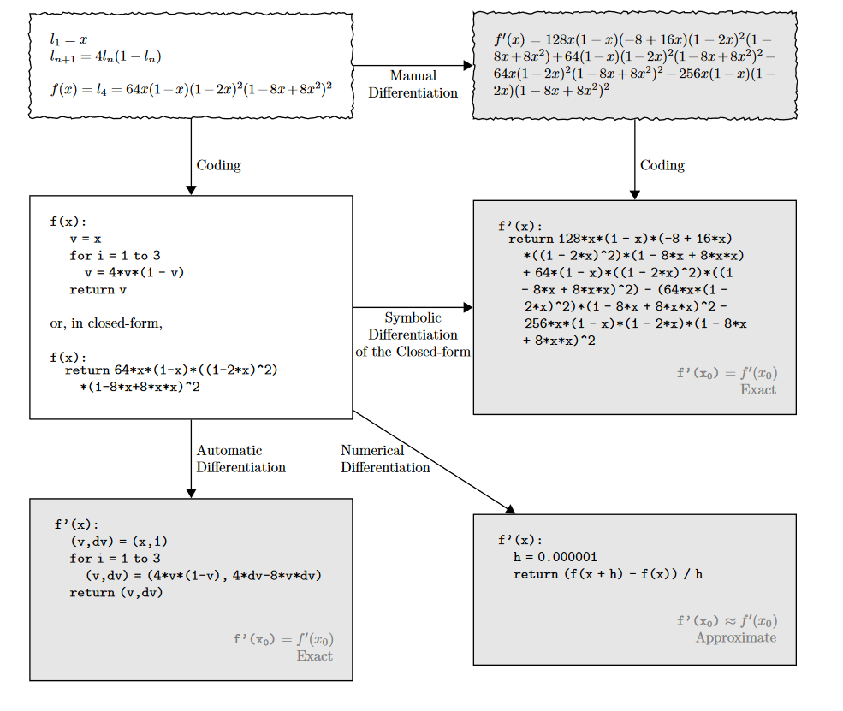
TYPES OF DIFFERENTIATION
There are three ways of performing differentiation –
Numerical Differentiation, but it might be slow and leads to numerical errors.
Symbolic Differentiation, but u need to provide closed form/ explicit functions.
Algorithmic Differentiation, which is far more superior than both.
There are several ways of implementing AD -
Source Transformation.
Expression Template.
Operator Overloading. (ADOL-C)
Using Compiler technology.
In all of the above method, the under lying process remains the same, i.e. obtaining the expression tree, and then using the above expression tree, to evaluate the derivatives.
Source Transformation
*https://arxiv.org/pdf/1502.05767.pdf

Slide 4
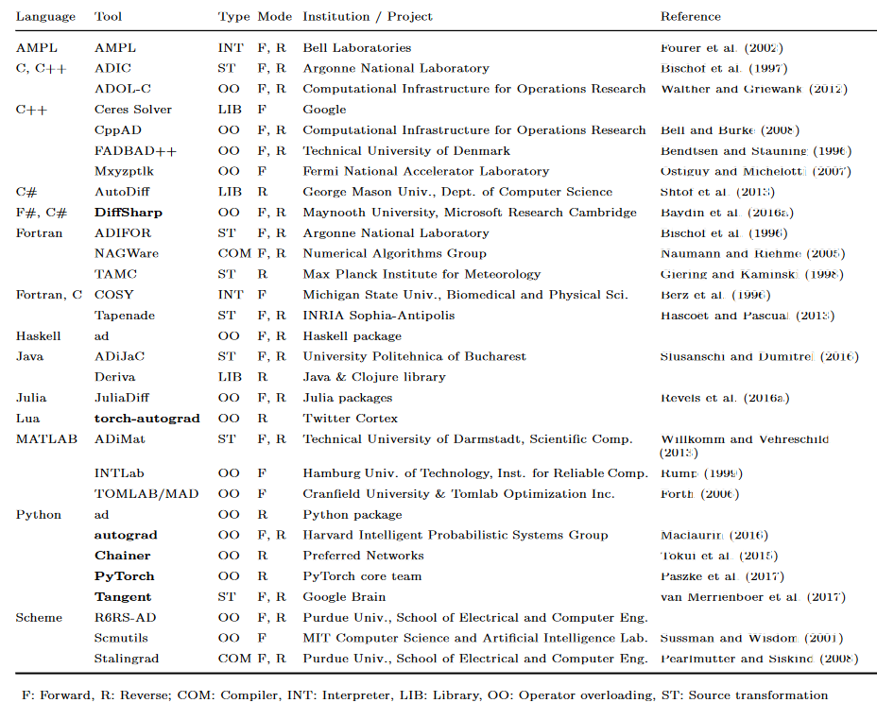
TOOLS
* https://arxiv.org/pdf/1502.05767.pdf

Slide 5
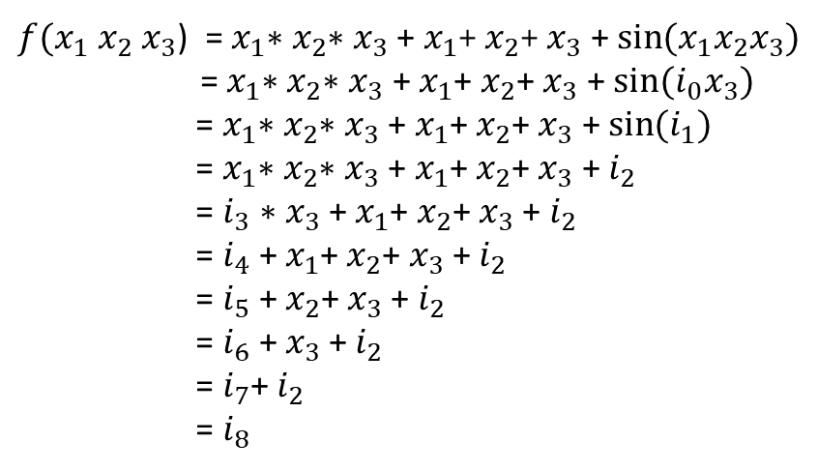
EXPRESSION TREE
There are few terms we need to familiarize ourselves with –
Chain Rule.
Expression Trees.
Operator Overloading.
Expression Tree
+
$f(x_{1} x_{2}$ $x_{3}$) = $x_{1}$∗$x_{2}$∗ $x_{3}$ + $x_{1}$+ $x_{2}$+ $x_{3}$ + $\sin{{(x}_{1}x_{2}x_{3})}$
= $x_{1}$∗$x_{2}$∗ $x_{3}$ + $x_{1}$+ $x_{2}$+ $x_{3}$ + $\sin{{(i}_{0}x_{3})}$
= $x_{1}$∗$x_{2}$∗ $x_{3}$ + $x_{1}$+ $x_{2}$+ $x_{3}$ + $\sin{{(i}_{1})}$
= $x_{1}$∗$x_{2}$∗ $x_{3}$ + $x_{1}$+ $x_{2}$+ $x_{3}$ + $i_{2}$
= $i_{3}$∗ $x_{3}$ + $x_{1}$+ $x_{2}$+ $x_{3}$+ $i_{2}$
= $i_{4}$+ $x_{1}$+ $x_{2}$+ $x_{3}$+ $i_{2}$
= $i_{5}$+ $x_{2}$+ $x_{3}$+ $i_{2}$
= $i_{6}$+ $x_{3}$+ $i_{2}$
= $i_{7}$+ $i_{2}$
= $i_{8}$
sin
+
*
+
*
+
x₁
x₂
x₃
*
Operator | Precedence | Associativity
functions | High | Left to right
* / | Medium | Left to right
+ - | Low | Left to right
*
x₁
x₂
x₃
x₁
x₂
x₃

Slide 6
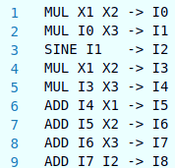



$f(x_{1} x_{2}$ $x_{3}$) = $x_{1}$∗$x_{2}$∗ $x_{3}$ + $x_{1}$+ $x_{2}$+ $x_{3}$ + $\sin{{(x}_{1}x_{2}x_{3})}$
+
+
One can even save these expression trees in a particular format in a file for later use.
Compiler helps us create this expression tree. We can use Operator Overloading to tap into this functionality of the compiler and create the expression tree for user defined objects.
sin
+
sin
+
+
TAPE / TRACE
*
+
+
*
+
*
x₁
x₂
x₃
*
*
*
x₁
x₂
x₃
x₁
x₂
x₃
x₁
x₂
x₃
Expression Trees
Directed Acyclic Graphs

Slide 7
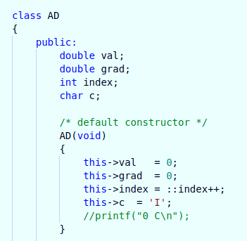
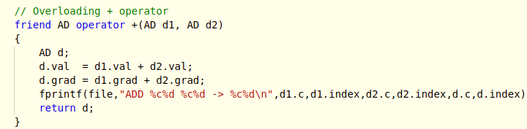
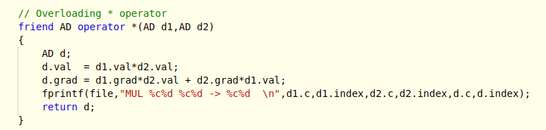
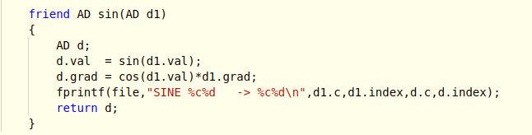
OPERATOR OVERLOADING
val
grad
*
+ sin

Slide 8
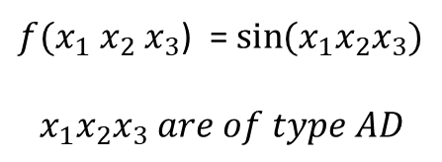
FORWARD MODE
_{i3.val = sin(40)}
_{i3.grad = 8*sin(40)}
Sin
$f(x_{1} x_{2}$ $x_{3}$) = $\sin{{(x}_{1}x_{2}x_{3})}$
$$x_{1}x_{2}x_{3} are of type AD$$
_{i2.val = 40}
_{i2.grad = 8}
_{(2*4) + (0*10)}
*
_{i1.val = 10}
_{i1.grad = 2}
_{(1*2) + (0*5)}
*
Three Forward runs, required.
Forward Mode Automatic Differentiation
_{x1.val = 5}
_{x1.grad = 1}
_{x2.val = 2}
_{x2.grad = 0}
_{x3.val = 4}
_{x3.grad = 0}

Slide 9

ADJOINT MODE
_{i3.val = sin(40)}
_{i3.grad = 1}
Sin
$f(x_{1} x_{2}$ $x_{3}$) = $\sin{{(x}_{1}x_{2}x_{3})}$
Compiler helps us create this expression tree. We can use Operator Overloading to tap into this functionality of the compiler and create the expression tree for user defined objects.
TAPE / TRACE
_{i2.val = 40}
_{i2.grad =}
*
_{i1.val = 10}
_{i1.grad =}
*
Single Reverse run, required.
Reverse Mode Automatic Differentiation
_{x1.val = 5}
_{x1.grad =}
_{x2.val = 2}
_{x2.grad =}
_{x3.val = 4}
_{x3.grad =}

Slide 10
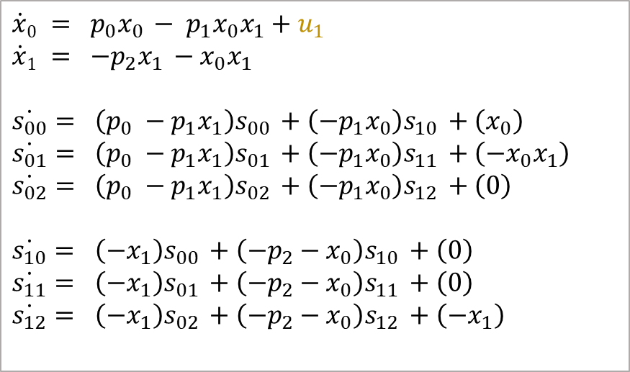

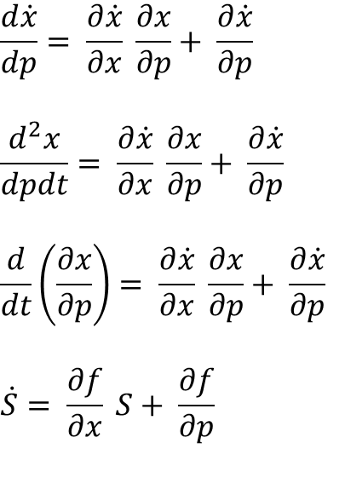
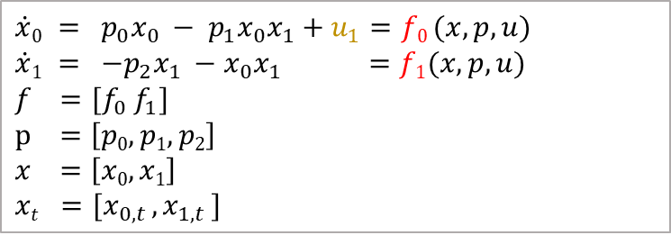



SENSITIVITY EQUATION FOR INPUT DESIGN
$$\dot{x}$$
$\dot{x}0 = p_{0}x_{0 }− p_{1}x_{0}x_{1}+u_{1}=f0 (x,p,u)$
$$\dot{x}1 = {−p}_{2}x_{1 }−x_{0}x_{1} =f1(x,p,u)$$
$$f =[f_{0} f_{1}]$$
$$p =\left[p0,p1,p2\right]$$
$$x =\left[x0,x1\right]$$
$$xt =[x_{0,t },x_{1,t }]$$
$$f$$
$$f$$
$$x$$
g
p
$$\frac{d\dot{x}}{dp}= \frac{∂\dot{x}}{∂x} \frac{∂x}{∂p}+ \frac{∂\dot{x}}{∂p}$$
$$\frac{d^{2}x}{dpdt}= \frac{∂\dot{x}}{∂x} \frac{∂x}{∂p}+ \frac{∂\dot{x}}{∂p}$$
$$\frac{d}{dt}\left(\frac{∂x}{∂p}\right)= \frac{∂\dot{x}}{∂x} \frac{∂x}{∂p}+ \frac{∂\dot{x}}{∂p}$$
$$\dot{S}= \frac{∂f}{∂x} S+ \frac{∂f}{∂p}$$
$\dot{x}0 = p_{0}x_{0 }− p_{1}x_{0}x_{1}+u_{1}$
$$\dot{x}1 = {−p}_{2}x_{1 }−x_{0}x_{1}$$
$$\dot{s_{00}}= \left(p_{0} −p_{1}x_{1}\right)s_{00 }+\left(−p_{1}x_{0}\right)s_{10 }+\left(x_{0}\right)$$
$$\dot{s_{01}}= \left(p_{0} −p_{1}x_{1}\right)s_{01 }+\left(−p_{1}x_{0}\right)s_{11 }+\left({−x}_{0}x_{1}\right)$$
$$\dot{s_{02}}= \left(p_{0} −p_{1}x_{1}\right)s_{02 }+\left(−p_{1}x_{0}\right)s_{12 }+\left(0\right)$$
$$\dot{s_{10}}= \left(−x_{1}\right)s_{00 }+\left(−p_{2}−x_{0}\right)s_{10 }+\left(0\right)$$
$$\dot{s_{11}}= \left(−x_{1}\right)s_{01 }+\left(−p_{2}−x_{0}\right)s_{11 }+\left(0\right)$$
$$\dot{s_{12}}= \left(−x_{1}\right)s_{02 }+\left(−p_{2}−x_{0}\right)s_{12 }+\left({−x}_{1}\right)$$
These are calculated using automatic differentiation

Slide 11
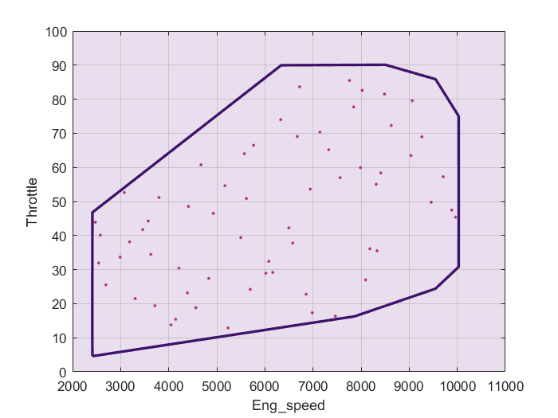
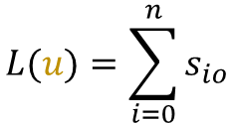
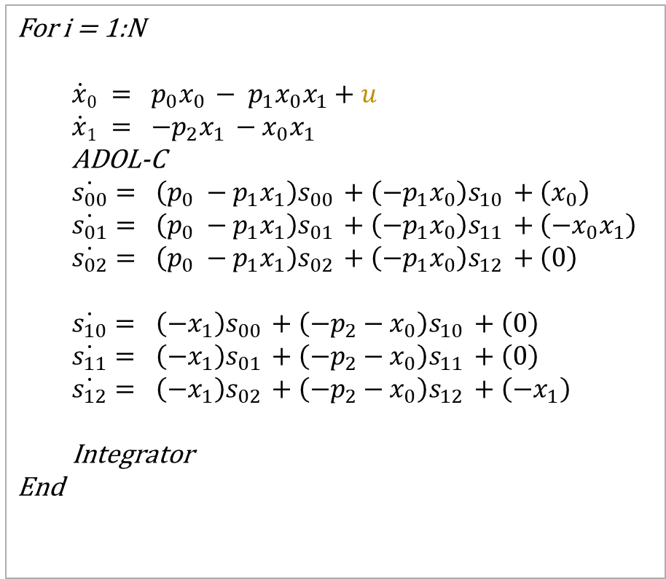
INPUT DESIGN
For i = 1:N
$$\dot{x}0 = p_{0}x_{0 }− p_{1}x_{0}x_{1}+u$$
$$\dot{x}1 = {−p}_{2}x_{1 }−x_{0}x_{1}$$
ADOL-C
$$\dot{s_{00}}= \left(p_{0} −p_{1}x_{1}\right)s_{00 }+\left(−p_{1}x_{0}\right)s_{10 }+\left(x_{0}\right)$$
$$\dot{s_{01}}= \left(p_{0} −p_{1}x_{1}\right)s_{01 }+\left(−p_{1}x_{0}\right)s_{11 }+\left({−x}_{0}x_{1}\right)$$
$$\dot{s_{02}}= \left(p_{0} −p_{1}x_{1}\right)s_{02 }+\left(−p_{1}x_{0}\right)s_{12 }+\left(0\right)$$
$$\dot{s_{10}}= \left(−x_{1}\right)s_{00 }+\left(−p_{2}−x_{0}\right)s_{10 }+\left(0\right)$$
$$\dot{s_{11}}= \left(−x_{1}\right)s_{01 }+\left(−p_{2}−x_{0}\right)s_{11 }+\left(0\right)$$
$$\dot{s_{12}}= \left(−x_{1}\right)s_{02 }+\left(−p_{2}−x_{0}\right)s_{12 }+\left({−x}_{1}\right)$$
Integrator
End
$$L(u)=\sum_{i=0}^{n}{s_{io}}$$

Slide 12
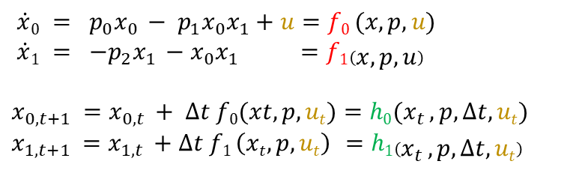
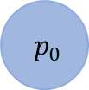


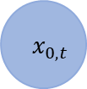
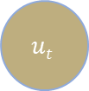
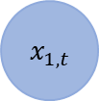

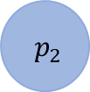

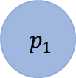
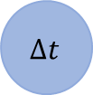
OPTIMAL CONTROL
$\dot{x}0 = p_{0}x_{0 }− p_{1}x_{0}x_{1}+u=f0 (x,p,u)$
$$\dot{x}1 = {−p}_{2}x_{1 }−x_{0}x_{1} =f1\left(x,p,u\right)$$
$$x_{0,t+1 }=x_{0,t }+ ∆t f0(xt,p,ut)=h0(x_{t },p,∆t,ut)$$
$$x_{1,t+1 }=x_{1,t }+∆t f1 \left(xt,p,ut\right) =h1\left(x_{t },p,∆t,ut\right)$$
$$H(x_{t},u_{t})$$
$$H(x_{t},u_{t})$$
$$x_{0,t }$$
*
₋
*
$$x_{1,t }$$
₊
*
₊
$$x_{0,t+1 }$$
*
$$x_{0,t }$$
*
₋
*
$$p_{0}$$
$$∆t$$
$$x_{1,t }$$
*
₊
*
₊
₊
$$x_{1,t+1 }$$
$$p_{0}$$
$$∆t$$
*
₊
*
$$p_{1}$$
*
₋
₊
$$p_{2}$$
$$ut$$
$$p_{1}$$
₊
*
₋
$$p_{2}$$
$$ut$$

Slide 13





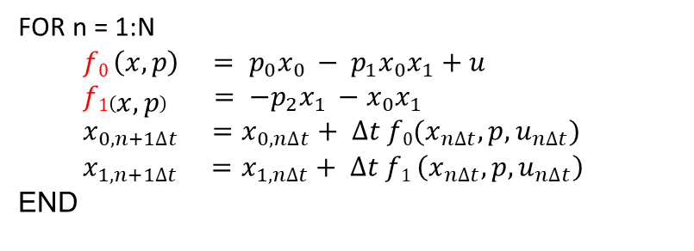




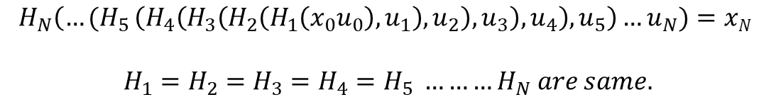

FOR n = 1:N
$$f0 \left(x,p\right) = p_{0}x_{0 }− p_{1}x_{0}x_{1}+u$$
$${f1\left(x,p\right) = −p}_{2}x_{1 }−x_{0}x_{1}$$
$$x_{0,n+1∆t} =x_{0,n∆t}+ ∆t f0(x_{n∆t},p,u_{n∆t})$$
$$x_{1,n+1∆t} =x_{1,n∆t}+ ∆t f1 \left(x_{n∆t},p,u_{n∆t}\right)$$
END
$$H_{N}\left({…(H}_{5}\left(H_{4}\left(H_{3}\left(H_{2}\left(H_{1}\left(x_{0}u_{0}\right),u_{1}\right),u_{2}\right),u_{3}\right),u_{4}\right),u_{5}\right)…u_{N})=xN$$
$$H_{1}=H_{2}=H_{3}=H_{4}=H_{5} ………H_{N} are same.$$
$$H(x_{t},u_{t})$$
FORWARD SWEEP – during this phase we will accumulate the values
$$x_{0,t }$$
*
₋
*
$$x_{0,t }$$
*
₋
*
$$x_{0,t }$$
*
₋
*
$$x_{0,t }$$
*
₋
*
$$x_{0,t }$$
*
₋
*
$$x_{0,t }$$
*
₋
*
$$x_{0,t }$$
*
₋
*
……….
$$x_{0,t }$$
*
₋
*
₊
$$x_{1,t }$$
*
₊
*
₊
$$x_{1,t }$$
*
₊
*
₊
$$x_{1,t }$$
*
₊
*
₊
$$x_{1,t }$$
*
₊
*
₊
$$x_{1,t }$$
*
₊
*
₊
$$x_{1,t }$$
*
₊
*
₊
$$x_{1,t }$$
*
₊
*
₊
$$x_{1,t }$$
*
*
₊
$$p_{0}$$
$$∆t$$
*
₊
$$p_{0}$$
$$∆t$$
*
₊
$$p_{0}$$
$$∆t$$
*
₊
$$p_{0}$$
$$∆t$$
*
₊
$$p_{0}$$
$$∆t$$
*
₊
$$p_{0}$$
$$∆t$$
*
₊
$$p_{0}$$
$$∆t$$
*
₊
$$p_{0}$$
$$∆t$$
*
₊
$$p_{1}$$
*
₋
₊
$$p_{1}$$
*
₋
₊
$$p_{1}$$
*
₋
₊
$$p_{1}$$
*
₋
₊
$$p_{1}$$
*
₋
₊
$$p_{1}$$
*
₋
₊
$$p_{1}$$
*
₋
₊
$$p_{1}$$
*
₋
₊
$$p_{2}$$
$$ut$$
$$p_{2}$$
$$ut$$
$$p_{2}$$
$$ut$$
$$p_{2}$$
$$ut$$
$$p_{2}$$
$$ut$$
$$p_{2}$$
$$ut$$
$$p_{2}$$
$$ut$$
$$p_{2}$$
$$ut$$
$$u_{1}$$
$$u_{2}$$
$$u_{3}$$
$$u_{4}$$
$$u_{5}$$
$$u_{6}$$
$$u_{7}$$
$$u_{N}$$
$$⋮$$
REVERSE SWEEP – during this phase we will calculate the derivatives $\frac{∂L}{∂u_{i}}$

Slide 14
THE END
CONCLUSION

